Slide 1
Analysis of ANNUAL REPORTS For OVER YEARS(IBM) USING NLP

Slide 2
Aim: Performing sentimental analysis and obtaining results, auto summarization for paragraphs, Q & A bot to answer about stocks
Using Annual reports for over decades from the website(Used 2022 year)(IBM) https://www.annualreports.com/Company/international-business-machines-corp
Using spacy to break into sentences(en_core_web_sm)
normalization → tokenization → sentence duplication → POS tagging

Slide 3
I manually labelled 4 sentences for positive, negative, and neutral Usedpipeline, Transformers ->Pretrained->Finbert model
The slide shows the positive, negative, and neutral sentiments, from the picture we can say that the neutral sentiments are higher when compared to positive.
Some 10 sentences which are of different sentiments are here:

Slide 4
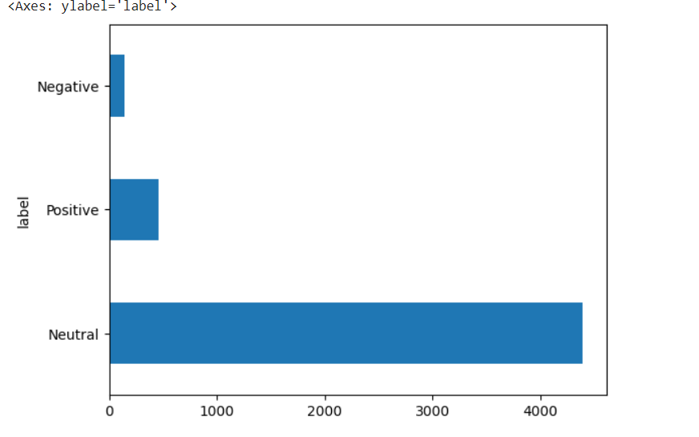

Slide 5
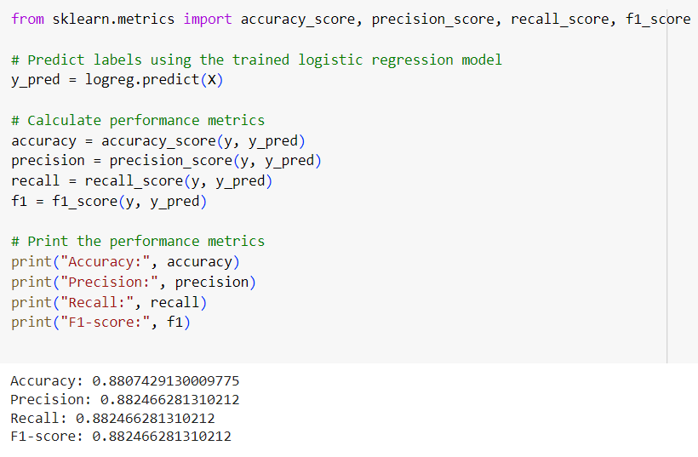

Slide 6
Examples of sentences for 'Neutral': - it may be obligated to indemnify the other party with respe ct to . - in previous periods mainly due to changes in estimates on cont racts with cost-to-cost measures of progress. - For all other standards that the company adopted in the periods pres ented, there was no material impact in the consolidated fin ancial . - IBM files reports with the Securities and Exchange Commission (S EC), including the annual report on Form 10-K, quarterly report s on .
Examples of sentences for 'Positive': - Technology Consulting: helps clients architect and implement solutions across cloud platforms, including Amazon, Microsoft and IBM, . - We had our best quarterly book-to-bill for 2022 - We have modernized and optimized our software capabilities to run on this platform across Automa tion, .
Examples of sentences for 'Negative': - associated with each type of risk. . - The company strongly disagrees with the IRS on these specific matte rs and . - At mid-January spot rates, currency tr anslation would be fairly neutral to revenue in 2023, with a headwind .

Slide 7
Auto summarization
# Load tokenizer and model for summarization
sum_tokenizer = AutoTokenizer.from_pretrained("facebook/bart-large-cnn")
sum_model = AutoModelForSeq2SeqLM.from_pretrained("facebook/bart-large-cnn")
Summary for 1024 sentences : Summary: Ibm is facing a series of specific business challenges: inflation,..supply chain disruption, tight labor markets, sustainability, and an ever-evolving cybersecurity threat..

Slide 8
Q & A MODEL
For Q & A session I used following prompts:
Prompt 1 : In 2022 did ibm face any challenges?
Ans: Business challenges
Prompt 2 :IBM profits in 2022?
Ans : '$60.5 billion in revenue and $9.3’
Prompt 3 : Is it safe to invest?
Ans: sound strategy with speed

Slide 9
Challenges Faced by IBM: IBM faced several challenges in 2022, including issues related to inflation, supply chain disruption, tight labor markets, sustainability, and cybersecurity threats.
IBM's Financial Performance: IBM generated $60.5 billion in revenue and $9.3 billion in profits in 2022.
Investment Safety: While the summary and responses to the prompts indicate that IBM faced challenges in 2022, it also suggests that IBM has strategies in place to address these challenges and continue its operations. For example, the prompt response mentions that IBM has a "sound strategy with speed."

Slide 10
Financial Health: Analyzing IBM's financial statements, debt levels, cash flow, and profitability can provide insights into its financial health and stability.
I did current ratio analysis on IBM (for year 2022)and figured out that:
A current ratio of less than 1(one) means that the company's current liabilities exceed its current assets, suggesting that it may have difficulties meeting its short-term financial obligations.
022-06-30 0.88 for year 2023-2024(1.16,1.10)
2022-09-30 0.95
2022-12-31 0.92

